Slide 1
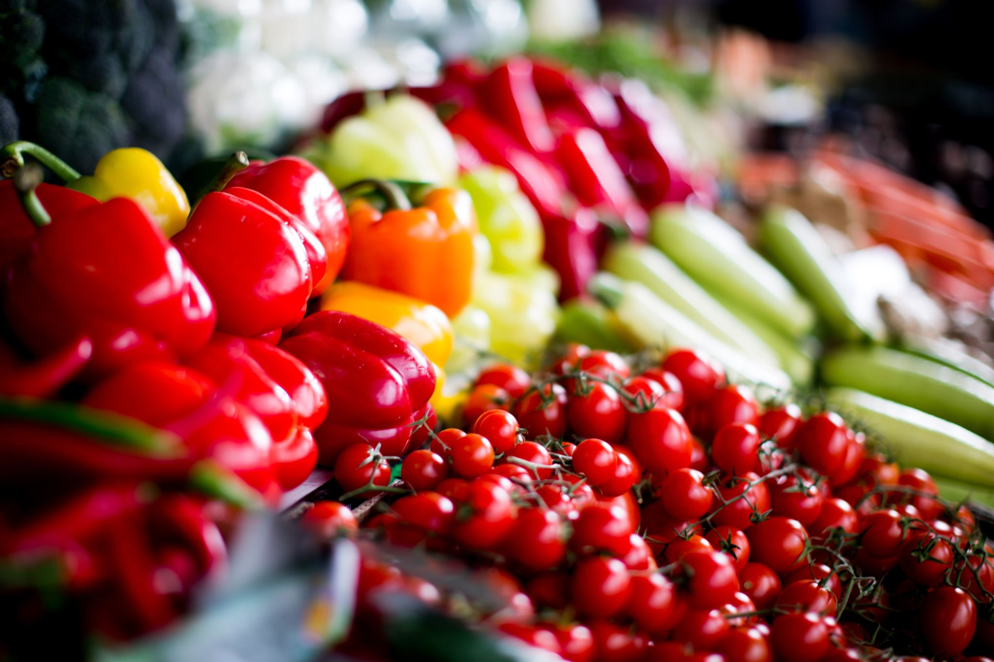
Cibo in circolo: un nuovo paradigma
Students:
Mărian Yasmine Stephanie
Ferica Erika Ana-Maria
Antohe Alexandru Constantin
Lăcătușu Eduard Ionuț

Slide 2
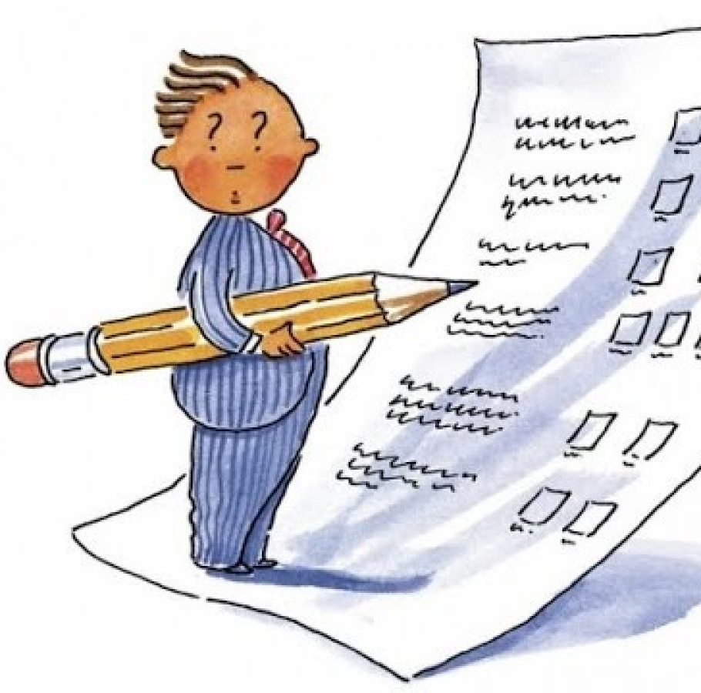
Questionnaire on the nutrition of the age group 10/19 years
1. Is there any connection for you between eating healthily and eating deliciously ?
2.Tell US 5 words which could describe your habits related to food?
3.Summarize in a few sentences the types of food you eat/ consume daily?
4.Are there any differences between the meals during the week and those during the weekend?

Slide 3
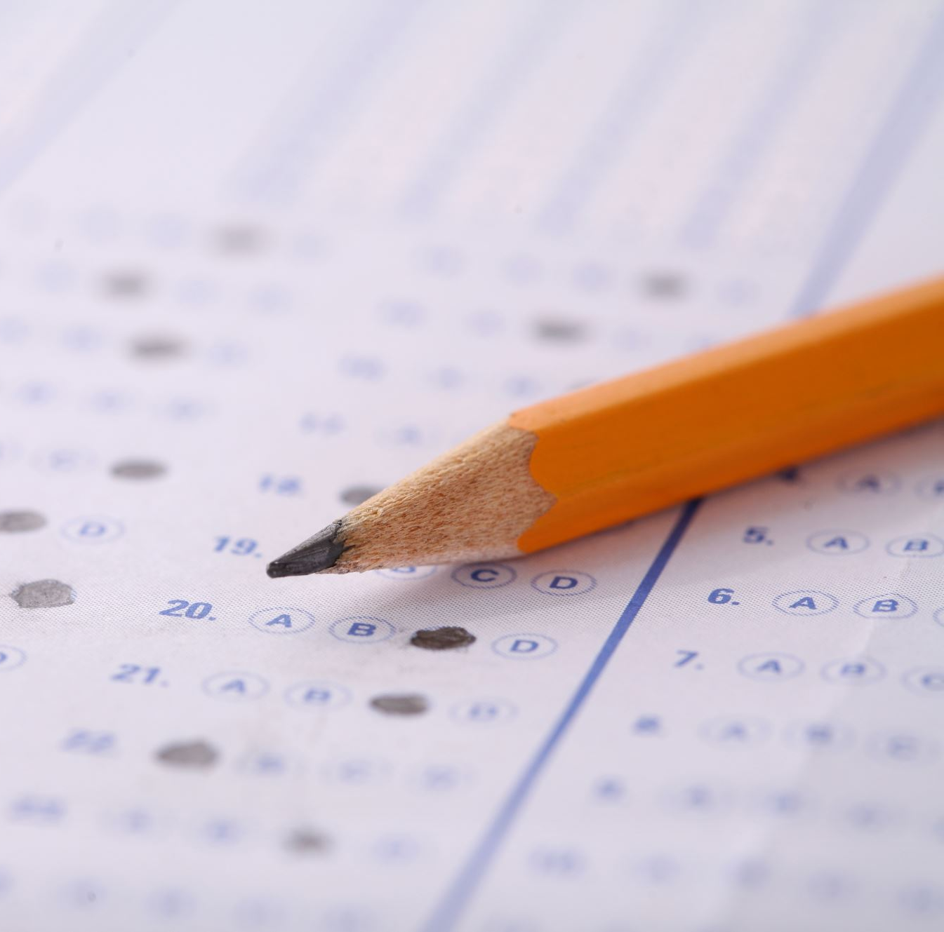
5.What criterion do you follow when buying groceries from the supermarket?
6.How big is the difference between the food you eat when you are happy, sad or angry?
7.What is your parents' opinion on the kind of food you prefer to consume?
8.How often do you eat fruit and vegetables? What about fast food?
9.What are your habits when you have your meal?
10.Do you think that your body reflects the food you eat?

Slide 4
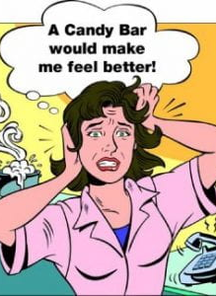
The conclusions of the questionnaire
In our interviews it can be seen two types of persons:The first one are people that know the variety of food that you can cook with supplies like vegetable and fruits.
Those who are not inform or have wrongfull informations and consider that a food full of vitamins is one without flavour. Those ones have told us that the food they consume is based on their emotional state from that day.
Then 8 out of 10 people state that when they feel alone, stressed or angry they tend to eat more food, hoping that will make them feel better.

Slide 5
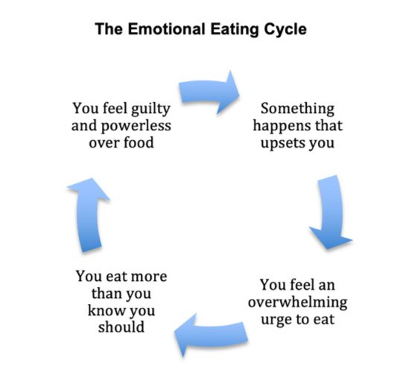
There are differences between your meals during the week and those during weekends?At the above question 70% of people said that for them friday represents an ecape door to a world without dietary restrictions.
Therefore if they have been eating a low calory imput during the week, they feel the need to relax with some snack, chocolate or fast-food.Through this interviews we have seen that when it comes to kids is normal to eat in front of a tv or in bed.They recognize that they do not realize when the food is finished and most of the times they do not realize what they were eating.
Due to this unconscious eating, watching tv or reading a paper, the percentage of obese children is rising alarming every year.

Slide 6
